Slide 1


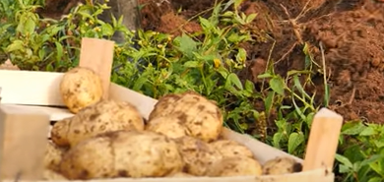
Machine Learning-Based Prediction of Potato Leaf Diseases for Improved Crop Management
Mini Project KCS 752/ 7th Sem
SUPERVISOR NAME
SHALINI SINGH
ASSISTANT PROFESSOR (SR.SCALE)
STUDENT NAME
BHARTI(2000320120063)

Slide 2
Outline
INTRODUCTION
EXISTING SYSTEM
PROPOSED SYSTEM
OBJECTIVES
TOOLS AND TECHNOLOGIES
DATASET
FLOWCHART
METHODOLOGY
IMPLEMENTATION
RESULTS
LIMITATIONS AND ENHANCEMENTS
CONCLUSION
REFERENCES

Slide 3
Introduction
Farmers who grow potatoes suffer from serious financial standpoint losses each year which cause several diseases that affect potato plants.
The diseases Early Blight and Late Blight are the most frequent.
Early blight is caused by fungus and late blight is caused by specific micro-organisms and if farmers detect this disease early and apply appropriate treatment then it can save a lot of waste and prevent economical loss.
The treatments for early blight and late blight are a little different so it’s important that you accurately identify what kind of disease is there in that potato plant.

Slide 4
Introduction
The cultivation of potatoes is constantly challenged by a range of diseases that affect the leaves, stems, and tubers of the plant.
These diseases can lead to reduced crop yield, lower quality produce, and economic losses for farmers.
Understanding and managing potato leaf plant diseases are crucial for sustainable agriculture and food security.
Potato leaf plant diseases encompass a variety of fungal, bacterial, and viral infections that primarily target the leaves of the potato plant.
The impact of these diseases on potato crops can be severe Behind the scene, we are going to use Convolutional Neural Network – Deep Learning to diagnose plant diseases.

Slide 5
Existing System
There were several existing potato leaf disease prediction
systems and technologies in use or development. These systems aimed to help farmers and researchers predict, diagnose, and manage potato leaf diseases.
Here are some examples:
Potato Disease Identification Apps
Computer Vision and Image Analysis
The availability and effectiveness of these systems can vary by region and the specific diseases prevalent in potato crops. Additionally, advancements in technology and research continue to contribute to the development of more accurate and accessible potato leaf disease prediction systems.

Slide 6
Proposed System
Here I have created a simple Image Classification Model that will categorize Potato Leaf Disease using a simple and classic Convolutional Neural Network Architecture.
CNNs are well-suited for image analysis tasks and can accurately classify images of potato leaves to identify disease symptoms.

Slide 7
Objectives
The objective of Potato Leaf Disease Prediction system are to:
1.Improve Crop Yield
2.Enhance Quality
3.Minimize Losses
4.Resource Optimization
5.Sustainability
6.Food Security
7.Empower Farmers
8.Cost Reduction
9.Accessibility
10.Research and Development

Slide 8
Tools and Technologies Used
Here are some of the key tools and technologies commonly used to effectively identify, monitor, and manage diseases affecting potato crops.in potato leaf disease prediction:
Image Recognition and Analysis: Convolutional Neural Networks (CNNs)
Data Collection
Data Processing and Analysis
Disease Models and Algorithms:Mathematical Models and Predictive Algorithms:
Artificial Intelligence and Machine Learning Libraries
Data Visualization Tools

Slide 9
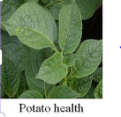
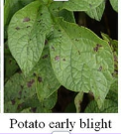
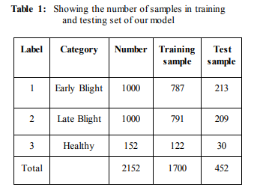
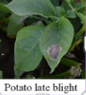
Dataset
https://www.kaggle.com/abdallahalidev/plantvillage-dataset
Late Blight: Late blight of potato is a disease caused by fungus Phytophthora infestans.
Early Blight: Early blight of potato is a disease caused by the fungus Alternaria solani
Healthy: Uninfected or healthy plant

Slide 10
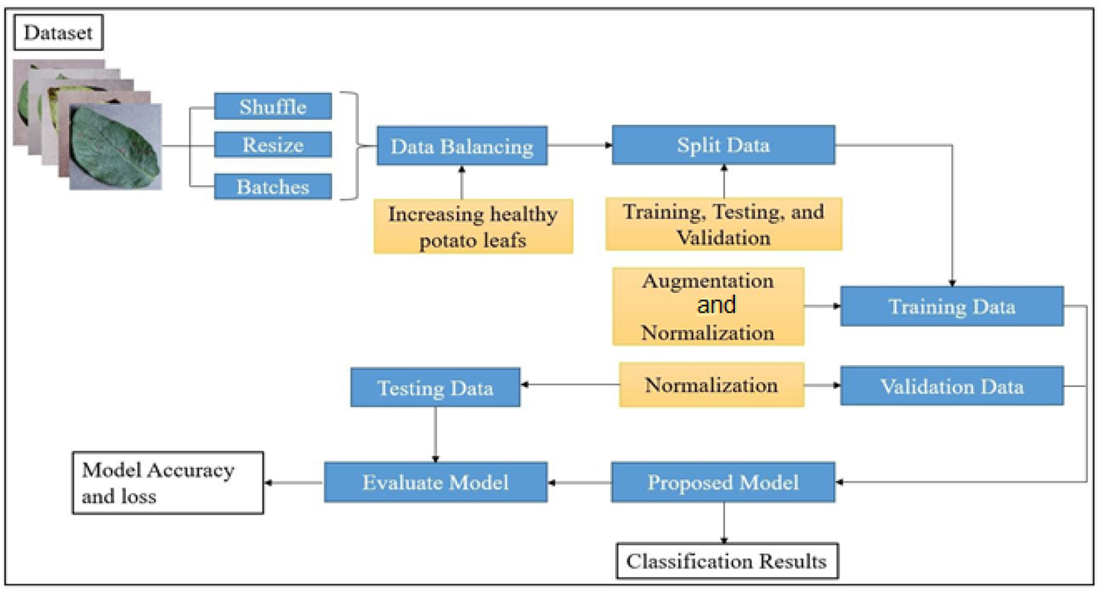
Flowchart

Slide 11
Methodology Used
Data Collection - Gather a dataset of potato leaf images. - Annotate images with disease labels (e.g., healthy, late blight, early blight). - Collect environmental data (e.g., weather, soil conditions).
Data Preprocessing - Split the dataset into training, validation, and test sets. - Resize and standardize images. - Augment data to increase diversity (optional). - Normalize environmental data.
Model Selection - Choose a suitable machine learning or deep learning model (e.g., CNN). - Fine-tune hyperparameters.
Model Training - Train the selected model using the training dataset. - Use environmental data and images for training. - Monitor training progress and adjust as needed.
Model Evaluation - Assess model performance using the validation dataset. - Calculate metrics like accuracy, precision, recall, F1-score. - Optimize the model if necessary.

Slide 12
Methodology Used
Testing - Evaluate the final model using the test dataset. - Record model accuracy and performance metrics.
Image Processing - Preprocess uploaded images (resize, normalize). - Pass images through the trained model for prediction.
Disease Prediction - Model predicts disease category (e.g., late blight, early blight). - Optionally, assess disease severity based on symptoms.

Slide 13
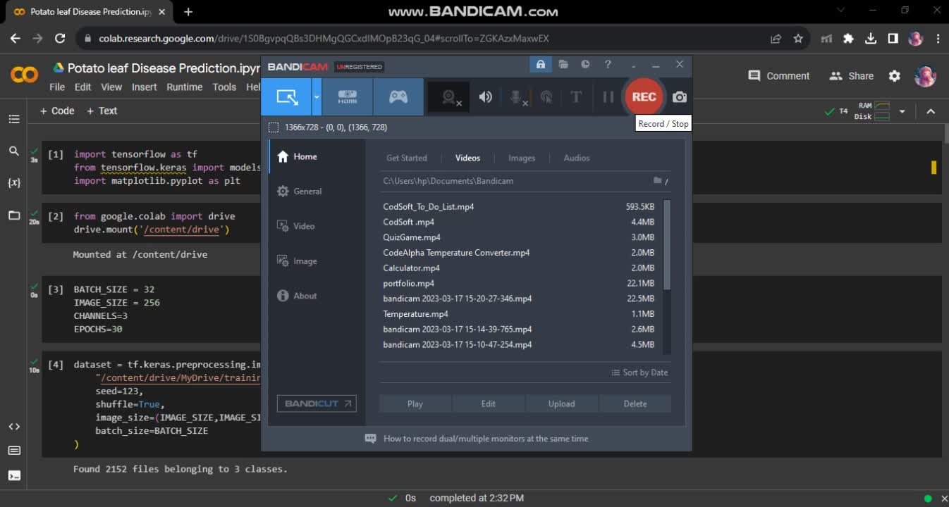
Implementation

Slide 14

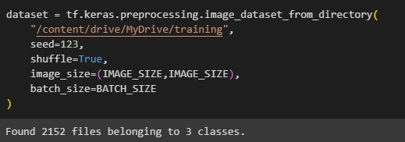
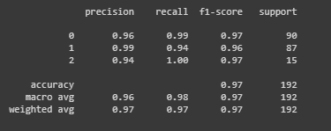
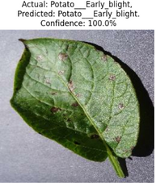
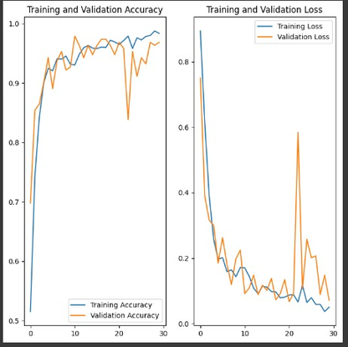
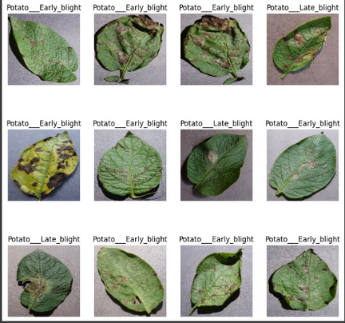
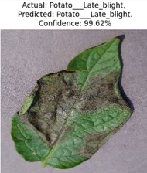
Implementation

Slide 15
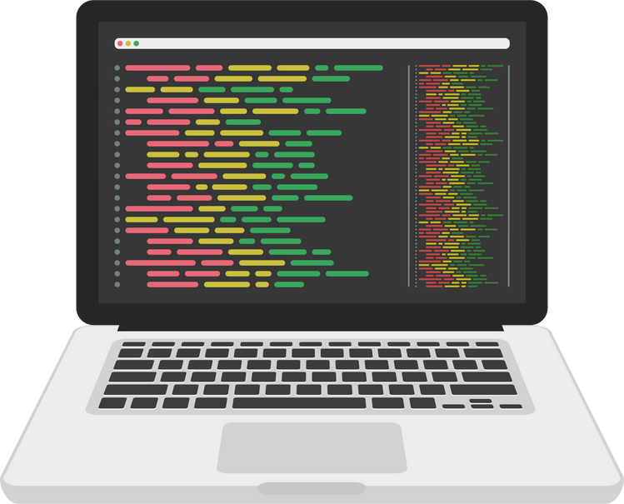
Implementation
CODE
https://colab.research.google.com/drive/1S0BgvpqQBs3DHMgQGCxdIMOpB23qG_04#scrollTo=D_PvFcu7Z3St

Slide 16
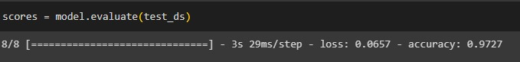
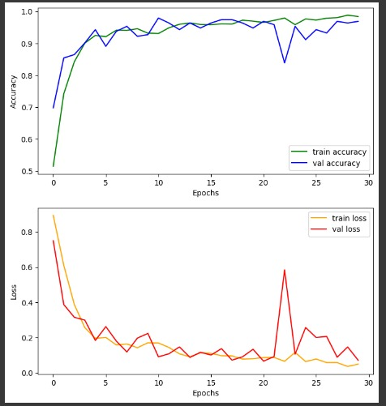
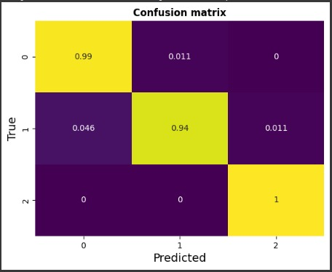
Results
Accuracy :- 97.27 Loss:- 6.57
0=Early blight, 1=healthy, 2=Late blight

Slide 17
Limitations &Future Enhancements
Limitations :-
Data Availability
Generalization
Hardware and Infrastructure
False Positives/Negatives
Future Enhancements-
Model Explainability
Multi-Disease Detection
Real-time Monitoring
Collaboration and Education

Slide 18
Conclusion
Potato leaf disease prediction systems leverage cutting-edge technology to mitigate the economic and environmental impact of diseases on potato crops. As these systems evolve and become more accessible, they hold the potential to transform potato farming practices, ensuring a healthier and more secure food supply for communities worldwide.

Slide 19
References
Md. Marjanul Islam Tarik, Sadia Akter, Abdullah Al Mamun, Abdus Sattar, “Potato Disease Detection Using Machine Learning”, IEEE Conference, 2021.
Potato Crop Disease Prediction using Deep Learning Publisher: IEEE Karthik Kasani; Sunanda Yadla; Sadhwika Rachamalla; Shanmugasundaram Hariharan; Likhitha Deva
https://www.kaggle.com/datasets/emmarex/plantdisease :- Dataset

Slide 20


